Slide 1
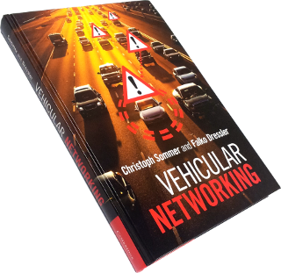
CSE 4615:: Wireless Networks
Understanding Vehicular Communication
Lecture 8.2
Course Teacher:
Ashraful Alam Khan
Assistant Professor, CSE, IUT
Content Contributors:
Christoph Sommer and Falko Dressler
Cambridge University
Johan J. Lukkien
TU/e Informatica, System Architecture and Networking

Slide 2
Course Material
Title | Vehicular Networking
Authors | Christoph Sommer and Falko Dressler
Publisher | Cambridge University Press
Date | December 2014
Format | Hardback (also available as eBook)
ISBN-10 | 1107046718
ISBN-13 | 9781107046719
Website | http://book.car2x.org
Book design © 2014 Cambridge University Press

Slide 3
Vehicular Networking
Book design © 2014 Cambridge University Press

Slide 4

About this slide deck
These slides are designed to accompany a lecture based on the textbook “Vehicular Networking” by Christoph Sommer and Falko Dressler, published in December 2014 by Cambridge University Press.
Except where otherwise noted (e.g., logos and cited works) this slide deck is Copyright © 2009-2015 Christoph Sommer, but made available to you under a Creative Commons Attribution-ShareAlike 4.0 International License.
In brief, this means you can share and adapt the slides as long as you follow the terms set out in this license [1]. If you split this slide deck into multiple parts, make sure to include appropriate attribution in each part.
This slide deck would not have been possible without the contributions of Falko Dressler, David Eckhoff, Reinhard German, and Kai-Steffen Jens Hielscher.
Please leave this slide intact, but indicate modifications below.
Version 2015-02
Improved version for release on book website (Christoph Sommer)
Updated versions of the original slide deck are available online [2].
[1] http://creativecommons.org/licenses/by-sa/4.0/
[2] http://book.car2x.org/

Slide 5
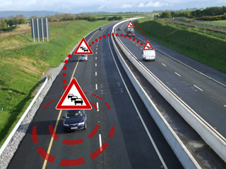
A Short Introduction
…to Vehicular Networking
Illustration © 2010 Christoph Sommer

Slide 6
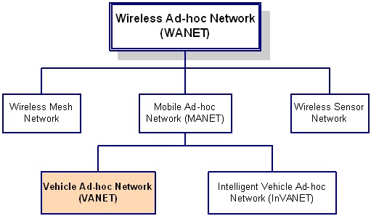
Introduction of VANET
Vehicular Ad-Hoc Network or VANET is an application of MANET that uses moving vehicles as nodes to create a mobile network [1].
Fig. 1. Types of Networks

Slide 7
Cont…
VANET turns every participating vehicle into a wireless router or node, allowing vehicles approximately 300m to 1 km of each other to connect and, in turn, create a network with a wide range.
VANET enables communication among the vehicles and roadside infrastructures. It makes transportation systems more intelligent. Since the movement of vehicles are restricted by roads, traffic regulations we can deploy fixed infrastructure at critical locations [2].
The primary goal of VANET is to provide road safety measures where information about vehicle’s current speed, location coordinates are passed with or without the deployment of infrastructure. Apart from safety measures, VANET also provides value added services like email, audio/video sharing etc [3].
The best example of VANET is Transport System of any travel agency or any company which is joined internally.

Slide 8
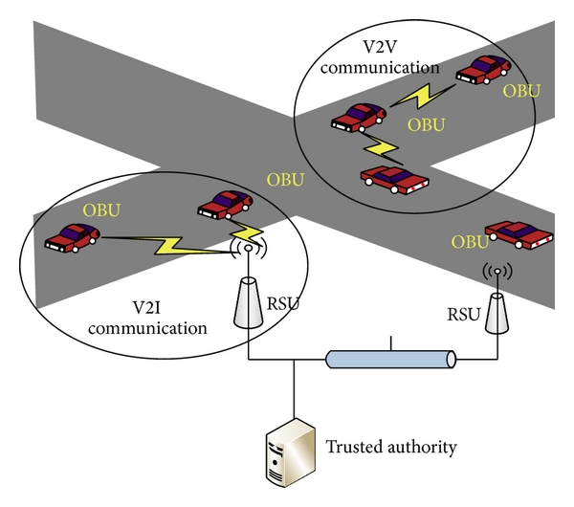
Components of VANET
The major components of a VANET are :
On-Board Unit (OBU)
Road Side Unit (RSU)
Trusted Authority (TA)
Fig. 2. VANET Architecture[4]

Slide 9
Cont…
OBUs are installed in vehicles to provide wireless communication capability.
While RSUs are deployed on intersections or hotspots as an infrastructure to provide information or access to the Internet for vehicles within their radio coverage.
The AS is responsible for installing the secure parameters in the OBU to authenticate the user

Slide 10
Cont…
DSRC (Dedicated Short Range Communications), WAVE (Wireless Access in Vehicular Environments) or even IEEE 802.11p are used to designate the entire protocol stack of standards dealing with VANETs.
An intelligent vehicle as it was designed in incorporates basically a set of sensors (front radar, reversing radar, etc.) that receive useful environmental information that generally the driver alone is unable to perceive. We find also a positioning system such as GPS (Global Positioning System) for example, which is essential for locating and driving assistance. A smart vehicle is obviously equipped with a communication system (can be multi-interface), a computing system, an event recording device which is a device whose functioning is similar to the black box of an aircraft.
Mainly, and for security measures, a smart vehicle must be equipped with an ELP (Electronic License Plate) or with ECN (Electronic Chassis Number) which represent the electronic identity of the vehicle instead of the conventional identification by license plates. The ITS current terminology includes some features such as transceiving, display and interactivity with the driver in a single unit called OBU.

Slide 11
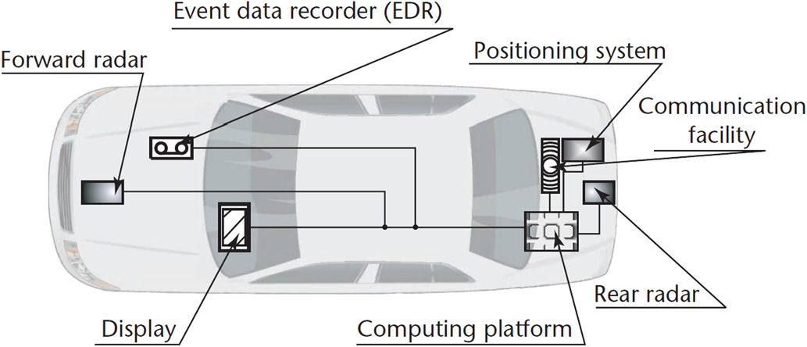
Smart Vehicle

Slide 12
Components of VANET
Vehicles
Electronic and hardware components like sensors and actuators, also software components like operating systems, diagnostics software, peripheral drivers and so on.
Intelligent Actuators are five separate main units of the vehicle
(Engine, Transmission, Suspension, Brake system and Steering system )
Integrated Vehicle Control which has an influence on the movement of the whole vehicle.
Sensor devices
(Radar, Video Camera, and Lidar “static laser Scanner, in 1 direction”)
Road side Unites.
Control of Vehicle Groups and Fleets

Slide 13
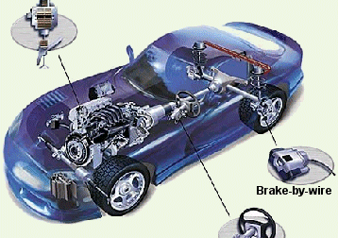
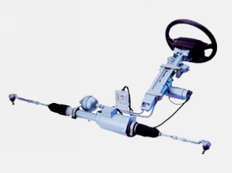
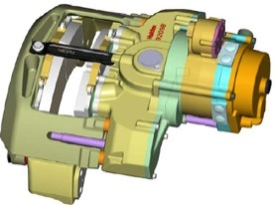
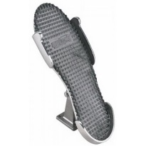
Vehicles operate using networked ICT
Driver
Control
In-car network
Local
Control
Local
Control
Local
Control

Slide 14
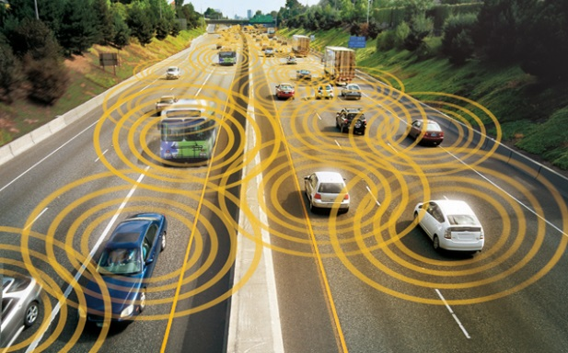
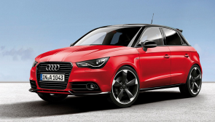
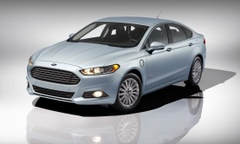
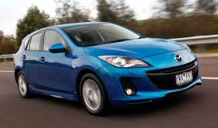
Vehicles become parts of a larger whole
Vehicle to Vehicle (V2V) communication
ad-hoc
collaborative applications
Applications are distributed
Actuation may pass by driver control
Accident prevention
V2V network
Driver
Control
Driver
Control
Driver
Control

Slide 15
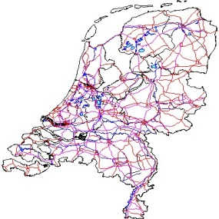

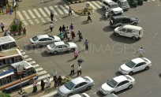
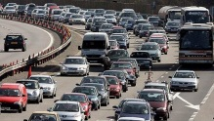






A conceptual view
Congestion control
Road maintenance
Environment control
End-user applications
Car sharing
Event management
Example data flows:
(1) gather detailed driving data to determine
local weather
road condition
(2) accident prevention by direct intervention
(3),(4) informing driver about upcoming road conditions
(1)
(3)
Internet, V2I
Accident prevention
V2V
V2V
(4)
(2)
V2V network
Driver
Control
Driver
Control
Driver
Control
In-car network
Local
Control
Local
Control
Local
Control

Slide 16
Physical organization in V2V
IEEE 802.3, (ethernet) IEEE 802.11 (WiFi)
……
IEEE 802.16e (WiMAX)
3G, 4G
IP-based network with wide-area coverage, wireless or wired
Road side units (RSUs, network central devices) are connected to the Internet
RSU
RSU
RSU
Vehicle
Vehicle
Moving vehicles connect ad-hoc to each other and to access points of the ambient infra structure
Technology: IEEE 802.11p
Vehicle
Vehicle
Vehicle
IEEE 802.11p

Slide 17
Executive Summary
The Concept
vehicle-to-vehicle (V2V).
The Opportunity
Smart Cars
The Potentials
Safer roads
Less traffic
Less fading

Slide 18
Visionary Applications
Lane assistant
Simple roadside beacons support lane detection
Lateral collision avoidance
More advanced beacons on cars and motorcycles help maintain minimum separation
Accident reporting
Broken down cars can automatically send simple report to central server
Intersection assistance
Pairs of cars automatically coordinate complex maneuvers at intersections
Cooperative driving
The future evolution of autonomous driving: vehicles actively support each other’s route planning, navigating, driving

Slide 19
Visionary Applications
...and much (much) more:
Emergency Brake Light Warning, Accident Warning, Emergency Flashlights, Traffic Jam Warning, Weather Warning, Emergency Vehicle, Slow Vehicle, Moving and Static Road Works, Obstacle Warning, Intersection Maneuvering Assistance, Intersection Traffic Lights, Lane Change, Maneuvering Assistance, Longitudinal Maneuvering Assistance, Floating Car Data Collection, Free-Flow Tolling, Breakdown Call, Remote Diagnostics, Theft Detection, Emergency Call, Just-In-Time Repair Notification, Roadside Traffic Camera pull, In-vehicle signing pull, Regional Information pull, Car-specific Software Application Download pull, Electronic Payment pull, Logistic for goods being loaded and unloaded, Traffic Information Service pull, Traffic Information Service push, Electronic Payment push, Roadside Traffic Camera push, In-vehicle signing push, Car specific Software Application Download push, Telemetric Onboard/Off-board Diagnostics, Remote Vehicle Status Control, Fleet Management, Server based navigation, Remote lock-down, Remote entry, Mobile Office, Videophone, Personal Data Synchronization at home, General Map Downloads and Updates, Instant Messaging, General internet services, Internet Audio, continuous feed, Web Browsing, Movie rental, Remote Home Activation/Deactivation pull, Remote Home Control pull, Remote Home Activation/Deactivation push, Remote Home Control push, Voice Chat, Games, Electronic Toll Collection, Parking Unit Fee Payment (drive through payment), Goods and services discovery and payment, Guided Tour, Interactive Lights Dimming, Emergency Traffic Light Pre-emption, Traffic Light Assistant, …
Source: C2CCC, Aktiv-AS/VM

Slide 20
Visionary Applications (Classified)
The aim of VANET is to improve driving experience and the safety of transportation [5].
1. Safety Application (to enhance driving safety):
EEBL – Emergency Electronic Brake Light (sudden braking)
PCN – Post Crash Notification
RFN – Road Feature Notification (ex. downhill curve)
LCA – Lane Change Assistance

Slide 21
Cont…
2. Convenience Application (for better driving experience):
Road Congestion Notification
Dynamic Route/Travel Time Planning
Finding Parking Spots
3. Other Commercial/ Infotainment Application:
Free flow Tolling
Social Networking
Multimedia Content Exchange

Slide 22
C’est le Rush https://www.youtube.com/watch?v=Johmxw3cspA

Slide 23
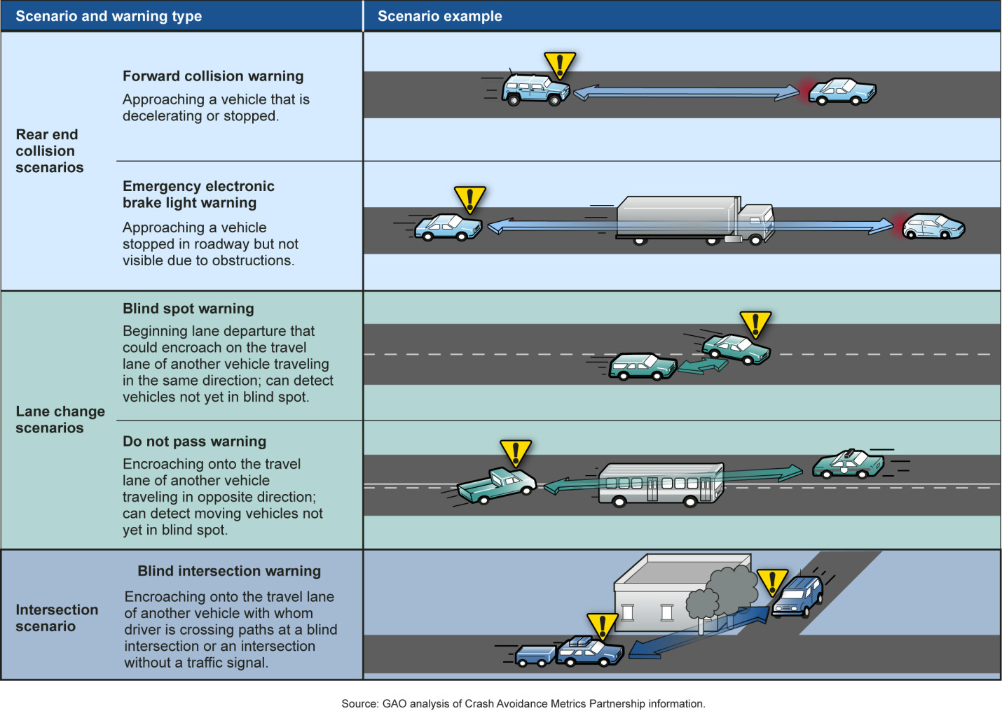
from: Vehicle-to-Vehicle Communications: Readiness of V2V Technology for Applications, NHTSA, August 2014

Slide 24
Some application examples (US WAVE BSM ~SAE J2735)
Apps. | Comm.type | Freq. | Latency | Range
Lane Change Warning | V2V, periodic, P2M | 10Hz | 100ms | 150m
Collision Warning | V2V, periodic, P2M | 10Hz | 100ms | 150m
Emergency Brake Lights | V2V, event-driven, P2M | 10Hz | 100ms | 300m
Pre-Crash Sensing | V2V, event-driven, P2P | 50Hz | 20ms | 50m
Stop Sign Assists | I2V and V2I, periodic | 10Hz | 100ms | 250m
Left Turn Assistance | I2V and V2I, periodic, P2M | 10Hz | 100ms | 300m
Traffic Signal Violation | I2V, periodic, P2M | 10Hz | 100ms | 250m
Curve Speed Warning | I2V, periodic, P2M | 1Hz | 1s | 200m
V2V = Vehicle to Vehicle
P2M = Point to Multipoint
I2V = Infra structure to Vehicle
Eight high priority vehicle safety applications as chosen by NHTSA and VSCC.
NHTSA – US National Highway Traffic Safety Administration
VSCC – Vehicle Safety Communication Consortium of CAMP (Crash Avoidance Metrics Partnership)
Notes:
Including road-side warning and Probe data (floating car data)

Slide 25
Cont…
The Emergency Electronic Brake Light (EEBL) application enables a vehicle to broadcast a self-generated emergency brake event to surrounding vehicles. Upon receiving the event information, the receiving vehicle determines the relevance of the event and if appropriate provides a warning to the driver in order to avoid a crash. This application is particularly useful when the driver's line of sight is obstructed by other vehicles or bad weather conditions (e.g., fog, heavy rain).
When a vehicle brakes hard, the Emergency Electronic Brake Light application conveys this information to surrounding vehicles via one or more Basic Safety Messages. This application will help the driver of a following vehicle by giving an early notification that the lead vehicle is braking hard even when the driver’s visibility is limited (e.g. a large truck blocks the driver’s view, heavy fog, rain).
The current brake lamp goes on when the driver applies the brake. The Emergency Electronic Brake Light application might not only enhance the range of a hard braking message but also might provide important information such as acceleration/deceleration rate and duration. At present, brake lamps do not differentiate level of deceleration and are only useful as far rearward as line of sight allows.

Slide 26
Cont…
A Post Collision Notification application detects an incident based on the speed and deceleration of each vehicle or node.
Lane Change Assist (LCA) uses radar sensors to help the driver to monitor the blind-spot area and the traffic situation behind the vehicle. Lane Change Assist measures the closing speed of an approaching vehicle in the adjacent lane to determine if changing lanes is safe and if it’s not, gives the driver an audible and visual warning.
Cooperative Collision Warning (CCW), which provides an active safety mechanism for vehicles on highways, is implemented by exchanging static and dynamic vehicle parameters with neighboring vehicles through inter-vehicle wireless communications. Received information is not only used for calculating the relative safety distance between neighboring vehicles, but also stored in a Motor Vehicle Event Data Recorder (MVEDR) for future accident investigation.

Slide 27
Cont…
The CCW concept provides warnings or situation awareness displays to drivers based on information about the motions of neighboring vehicles obtained by wireless communications from those vehicles, without use of any ranging sensors. Collision Warning Systems share a common need: the vehicle needs to know about the locations and motions of all the neighboring vehicles, representing the state of the vehicle neighborhood.
Most collision warning systems in the literature try to learn the state of the neighboring vehicles or roadway by using sensors like radar, laser, or vision (1) looking forward, to the rear, to the right lane and left lane. In contrast, our collision warning system develops its knowledge of the vehicle neighborhood by listening to the wireless communications of other vehicles and reciprocates with communications of its own.

Slide 28
Characteristics
High Mobility
Rapid Changing Network Topology
Predictable Mobility
No Power Criteria
Time Management [6]

Slide 29
Cont…
VANET is an application of MANET but it has its own distinct characteristics, the characteristics of VANETs are basically a mixture of wireless medium characteristics. The characteristics are:
1. High Mobility: - This is important features of the VANET as nodes move in a high speed all the time with different direction . The high mobility of nodes reduces the mesh in the network (fewer routes between nodes). Compared to MANET, VANET mobility is relatively high.
2. Rapid Changing Network Topology: - As nodes move in very high speed so the position of node changes frequently so therefore network topology in VANETs tends to change frequently. The connection times are short especially between nodes moving in opposite direction.
3. No Power criteria: - The VANET node is equipped with a battery that is used as an infinite power supply for the communication and computation task
4. Time Management: - Safety message are the main goal of VANET. Message in VANET must be delivered to the nodes within the time limit so that a decision can be made by the node and perform action according.
5. Wireless Communication: - Data transmission is generally done by nodes. Nodes are connected and exchange their information via wireless communication

Slide 30
Challenges of communication
Basic challenges
Timeliness
Throughput
Communication in vehicles: stresses...
Robustness
Cost
Communication across vehicles: also needs...
Interoperability
Reachability
Security
Privacy

Slide 31
Cont…
The main challenges of the VANETs can be summarized as follows:
Due to high mobility neighborhood location changes frequently-network Management.
The unbounded network size.(channel load) Congestion and collision Control:
Due to mobility signal power changes continuously.
Environmental impact VANETs uses the electromagnetic waves for communication.
Security as VANET provides the road safety applications which are life critical therefore security of these messages must be satisfied.

Slide 32
V2V: goals and characteristics
Goals
Safety
Comfort
Traffic efficiency
Safety applications have strict requirements on
Reliability
Delay

Slide 33
Car-to-X Networking

Slide 34
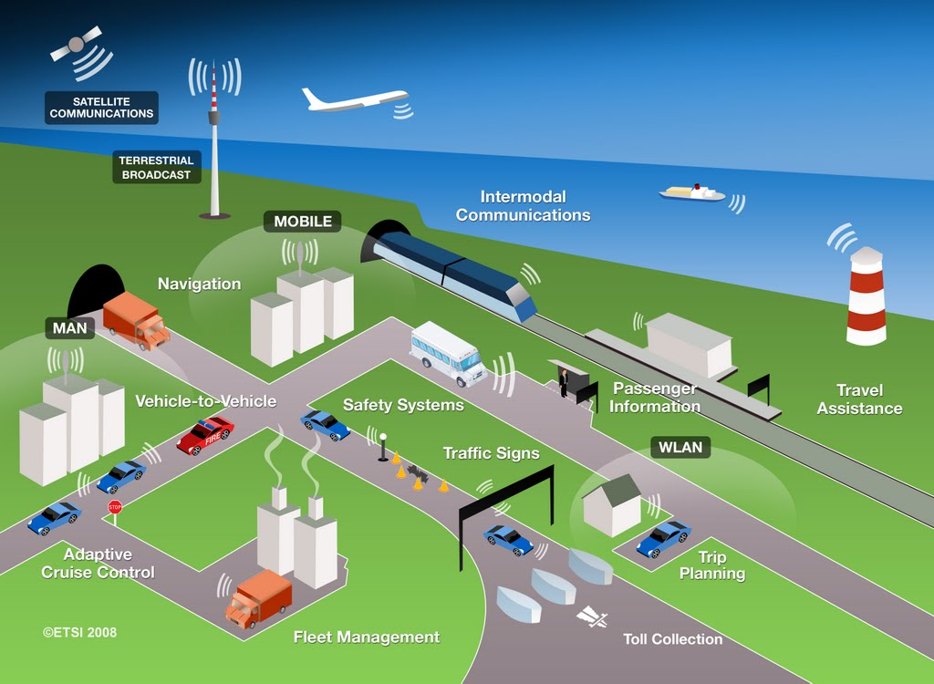
Vehicle-to-X (V2X) communication patterns
Vehicle-to-X (V2X),
Inter-Vehicle Communication (IVC),
Vehicular ad-hoc network (VANET),
…
… to vehicle
… to infrastructure
… to home
Illustration: ETSI

Slide 35
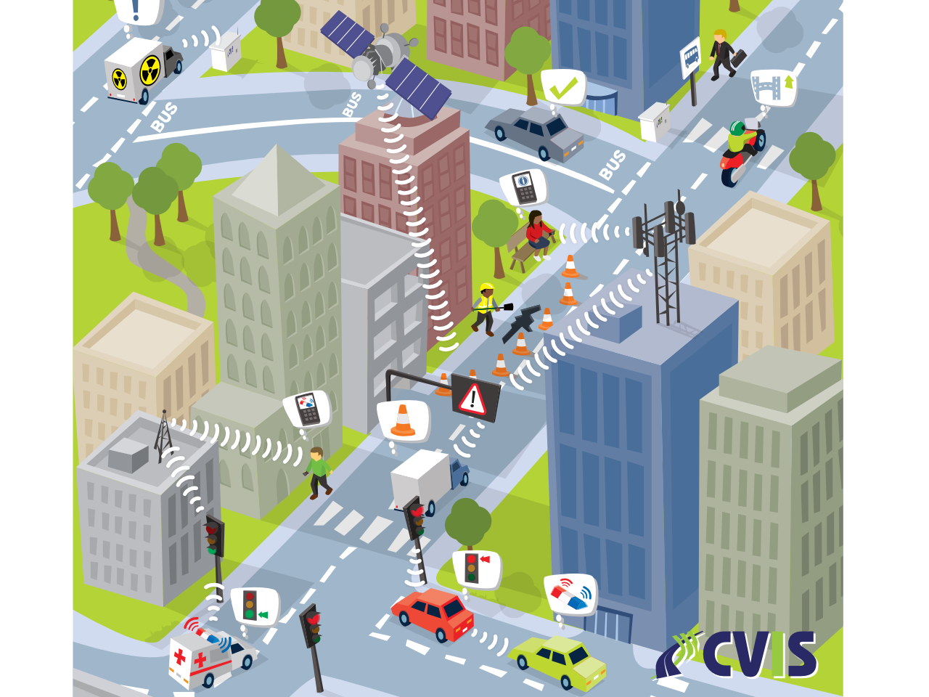
Use Cases
Illustration: CVIS
Illustration: CVIS

Slide 36
Taxonomy of Use Cases
Vehicle-to-X
Non-Safety
Safety
Adaptive Cruise Control
Comfort
Blind Spot Warning
Warning Messages
Electronic Brake Light
Traffic Information Systems
Optimal Speed Advisory
Situation Awareness
Contextual Information
Traffic Light Violation
Entertainment
Congestion, Accident Information

Slide 37
Taxonomy of Use Cases
Non-Safety
Safety
Vehicle-to-X
Many messages
High data rate
Few messages
Small packet size
Low latency demands
Low reliability demands
High latency demands
High reliability demands

Slide 38
Diversity of use cases
Application | Distance | Time | Recipient
Hazard warning | 250m | 10s | All
Location based service | 1..5km | Weeks | Subscribers
City wide alarm | 20km | Hours | All
Travel time information | 5km | Minutes | All
File sharing | 250m | Minutes (Index) Days (Content) | Subscribers (Index) Peers (Content)
Interactive Services | 1..5km | Minutes | Subscribers
[1] Bai, F. and Krishnamachari, B., "Exploiting the Wisdom of the Crowd: Localized, Distributed Information-Centric VANETs," IEEE Communications Magazine, vol. 48 (5), pp. 138-146, May 2010

Slide 39
Diversity of requirements
Application | Latency | Reliability | # Vehicles | Area | Persistence
Information Query | ★ | ★ | ★★★ | ★★★
Hazard Warning | ★★★ | ★★ | ★★ | ★★★
ACC, el. Brake Light | ★★★ | ★★ | ★ | ★
Cooperative Awareness | ★★ | ★★★ | ★ | ★ | ★
Intersection Assistance | ★★ | ★★★ | ★★ | ★★ | ★
Platooning | ★★★ | ★★★ | ★★ | ★ | ★
[1] T. L. Willke, P. Tientrakool, and N. F. Maxemchuk, "A Survey of Inter-Vehicle Communication Protocols and Their Applications," IEEE Communications Surveys and Tutorials, vol. 11 (2), pp. 3-20, 2009

Slide 40
Motivation
1970s: bold ideas
Very visionary, infrastructure-less solutions
Unsupported by current technology
Early interest of government and industry
working prototypes in: Japan CACS (1973–1979), Europe Prometheus (1986–1995), U.S. PATH (1986–1992)
No commercial success
1980s: paradigm shift
From complete highway automation ⇨ driver-advisory only
Infrastructure-less ⇨ infrastructure-assisted
chicken-and-egg type of standoff
New technology re-ignites interest
latest-generation cellular communication ⇨ early “Car-to-X” systems
e.g., On Star (1995), BMW Assist (1999), FleetBoard (2000), and TomTom HD Traffic (2007).
Sharp increase in computing power
Supports fully-distributed, highly reactive ad hoc systems
[1] W. Zimdahl, “Guidelines and some developments for a new modular driver information system,” in 34th IEEE Vehicular Technology Conference (VTC1984), vol. 34., Pittsburgh, PA: IEEE, May 1984, pp. 178–182.

Slide 41
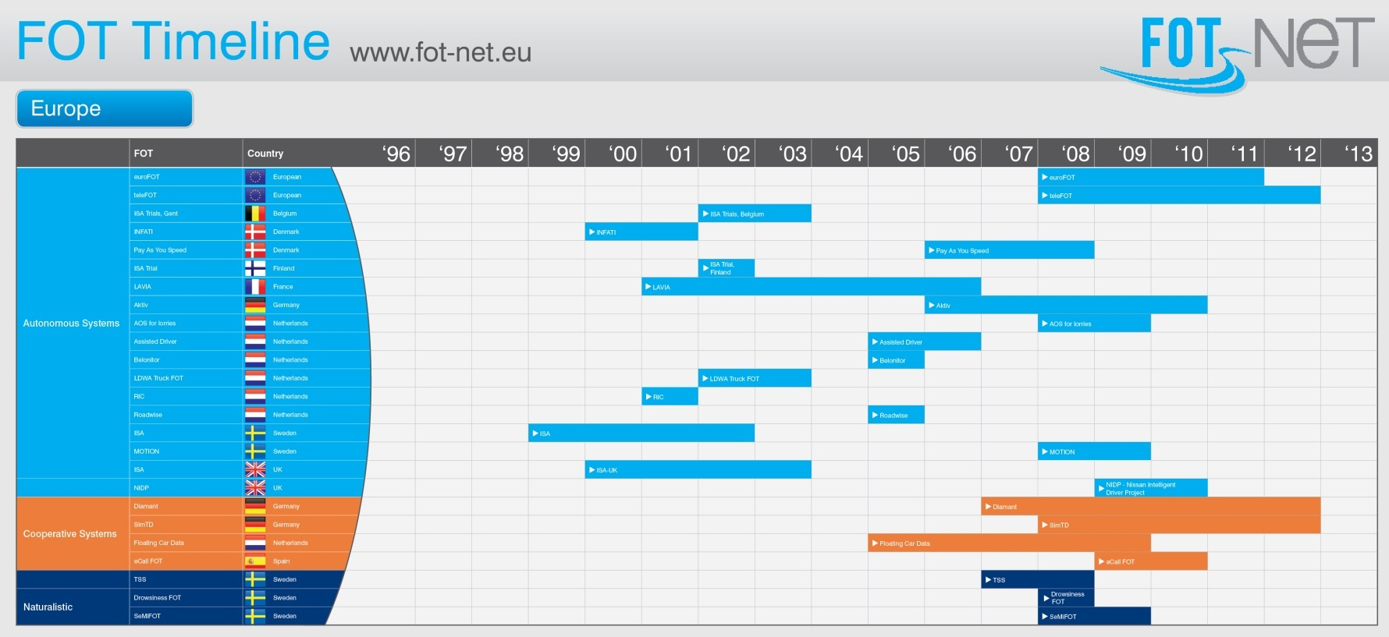
Renewed interest of government and industry
Numerous field operational tests
sim^{TD} (€ 69M), Aktiv (€ 60M), Smart Highway (€ 57M), Drive C2X (€ 19M), TeleFOT (€ 15M), SafeTrip (€ 10M), …
Dedicated spectrum in U.S., Europe, Asia
?
Illustration: FOT-NET Wiki

Slide 42







Motivation
Traditional Network
Connection: wired
Nodes: non-moving
Configuration: static
Mobile Ad Hoc Network (MANET)
Connection: wireless
Nodes: mobile
Configuration: dynamic
(Infrastructure: optional)
Vehicular Ad Hoc Network (VANET)
Not: “MANET on wheels”
Different topology dynamics, communication patterns, infrastructure, ...
[1] M. Scott Corson and Joseph Macker, "Mobile Ad hoc Networking (MANET): Routing Protocol Performance Issues and Evaluation Considerations,“ RFC 2501, January 1999

Slide 43
Freeway ⇔ Urban
1D mobility
Bimodal connectivity
Stable connection (vehicles on same lane)
AND
unstable connection (vehicles on opposite lane)
High speed
…
2D mobility
Bipolar connectivity
Many neighbors (when standing)
OR
Few neighbors (when driving)
Obstacles
…

Slide 44
Levels of infrastructure support
Pure ad hoc communication
Stationary Support Units (SSU)
Radio-equipped autonomous computer
Inexhaustible storage, energy supply
Known position, high reliability
Roadside Units (RSU)
SSU(System Synchronization Unit) plus…
Ethernet NIC, UMTS radio(3G Universal Mobile Telecommunications System), ...
Connected to other RSUs
Traffic Information Center (TIC)
Central server connected to RSUs

Slide 45
Infrastructure ⇔ No Infrastructure
Central coordination
Resource management
Security
High load on core network
Self organizing system
Channel access
Authentication
Low data rate
Source: AKTIV CoCar

Slide 46
Convergence towards heterogeneous approaches
Same system needs to work in multiple environments
Vehicle starts to drive in city with infrastructure support
Continues driving on freeway (still with infrastructure support)
Loses infrastructure support when turning onto local highway
Finishes driving in city without infrastructure support

Slide 47
Challenges of V2X communication
Communication
Highly varying channel conditions
Tightly limited channel capacity
Networking
Unidirectional Links (Broadcast, No Responce from Receiver)
Mobility
Multi-Radio / Multi-Network
But: predictable mobility
Security
No (or no reliable) uplink to central infrastructure
Highly dynamic topology
Heterogeneous equipment
Heterogeneous user base
Ensuring privacy
High congestion, contention, interference
Heterogeneous environment

Slide 48
Technology

Slide 49
Communication paradigms and media
Infrastructure-based
GSM 2G Cellular
Infrastructureless
Millimeter, Infrared, Visible
802.15.1 Bluetooth
802.15.4 ZigBee
DSRC / WAVE
UMTS 3G Cellular
LTE / WiMAX
4G Cell.
802.11 Wi-Fi
Broadcast
Short Range
Medium Range
FM Radio, DAB/DVB, …
Cellular
Wireless Communication Technologies
[1] Dar, K. et al., "Wireless Communication Technologies for ITS Applications," IEEE Communications Magazine, vol. 48 (5), pp. 156-162, May 2010

Slide 50
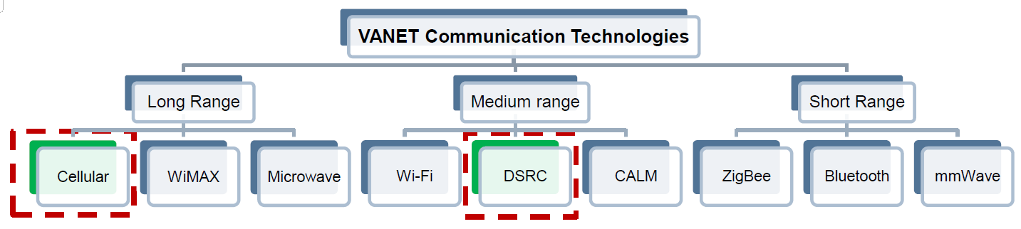
Communication paradigms and media
Cellular and DSRC prove to be potential communication technologies enabling connected cars
The two major vehicular wireless communication technological standards:
IEEE 802.11p (DSRC/WAVE)
Cellular V2X (C-V2X)

Slide 51
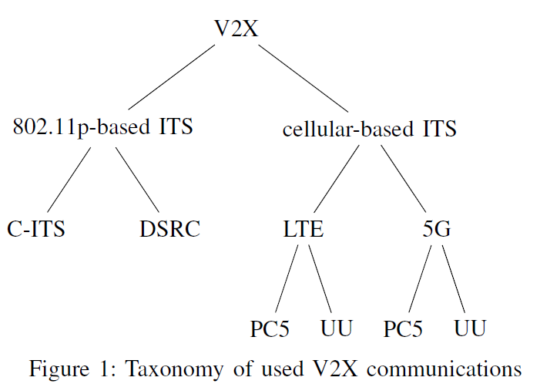
Communication Technologies
Notes:
European Union
Cooperative Vehicles and Infrastructure Systems is in charge of traffic control systems and implements a variety of driver
routing systems based on hazardous conditions.
The main objectives of this trial are to develop standards for V2V and V2I communications,

Slide 52

How does this work?
It is cooperative, dynamic and ad-hoc
Two different approaches, same network technology (IEEE 802.11p)
US: Wireless Access in Vehicular Environments – WAVE – over Dedicated Short Range Communications – DSRC
EU: ETSI TC ITS standards, using Geo-networking
Essentially: vehicles emit periodically or event-driven status information
called Basic Safety Messages (BSM, US)
and Cooperative Awareness Messages (CAM, EU)
picture from the Internet

Slide 53
IEEE 802.11p characteristics
Part of the full IEEE 802.11 (2800page) specification
enhancements for use in Vehicles
Connect without BSS (BSS: stations with access point):
no association, authentication
just direct, ad-hoc messaging when in range
Support prioritizing of traffic: EDCA (from 802.11e)
Deal with high relative speeds of terminals
UTC-based timing reference for synchronizing time accurately
Channels in the 5.9 GHz range (~300m in free field, max 1000)

Slide 54
US: WAVE/DSRC
IEEE 802.11p standard
A Dedicated Short Range Communication (DSRC) is proposed which is operating on 5.9GHz band and uses 802.11 access methods
provides short range communication with low latency.
add wireless access in vehicular environments (V2V, I2V Communications)
IEEE 1609 standard
family of standards that function in the middle layers of the protocol stack to flexibly support safety applications in VANETs .
J2735 standard
placed in the application layer
It defines message sets, data frames and elements which are used for V2V and V2I safety exchanges
Notes:
European Union
Cooperative Vehicles and Infrastructure Systems is in charge of traffic control systems and implements a variety of driver
routing systems based on hazardous conditions.
The main objectives of this trial are to develop standards for V2V and V2I communications,

Slide 55
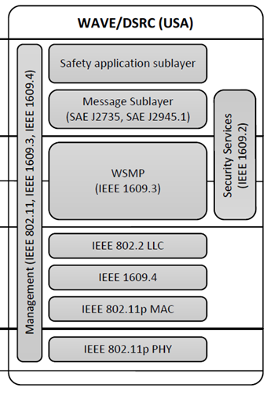
US: WAVE/DSRC
IEEE 1609 standardizes Wireless Access in Vehicular Environments over Dedicated Short Range Communication
1609.1: resource management
1609.2: security services
1609.3: networking services (a.o. wave short message protocol)
broadcasting of basic safety messages
define channel number and power per message
1609.4; multi-channel operation
SAE J2735
defines the message content of WSMP

Slide 56
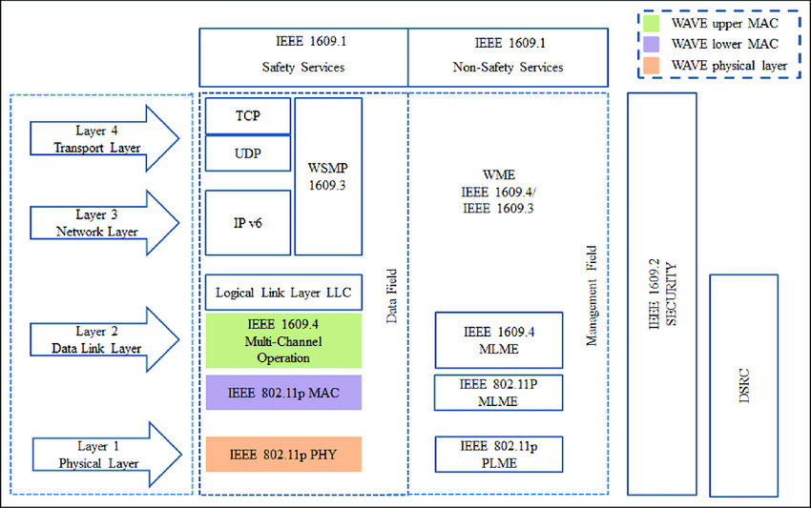
Protocol Stack: IEEE 802.11p (DSRC/WAVE)

Slide 57
Combining with Internet
Internet Apps
WAVE Apps
TCP/UDP
1609.x
(1,2,3)
IPv6
IP packet
WSMP
LLC/MAC (IEEE 802.11p with CSMA/CA)
P1609.4
PHY (IEEE 802.11p)
WAVE (Wireless Access in Vehicular Environment) standards:
IEEE 802.11p standard and 1609.x standards

Slide 58
IEEE 802.11{a,b,g,n} for Car-to-X communication?
Can’t be in infrastructure mode and ad hoc mode at the same time
Switching time consuming
Association time consuming
No integral within-network security
(Massively) shared spectrum (⇨ ISM)
No integral QoS
Multi-path effects reduce range and speed

Slide 59
IEEE 802.11p
IEEE 802.11p
PHY layer mostly identical to IEEE 802.11a
Variant with OFDM and 16 QAM
Higher demands on tolerances
Reduction of inter symbol interference because of multi-path effects
Double timing parameters
Channel bandwidth down to 10 MHz (from 20 MHz)
Throughput down to 3 ... 27 Mbit/s (from 6 ... 54 Mbit/s)
Range up to 1000 m, speed up to 200 km/h
MAC layer of IEEE 802.11a plus extensions
Random MAC Address
QoS (EDCA priority access, cf. IEEE 802.11e, ...)
Multi-Frequency and Multi-Radio capabilities
New Ad Hoc mode
...

Slide 60
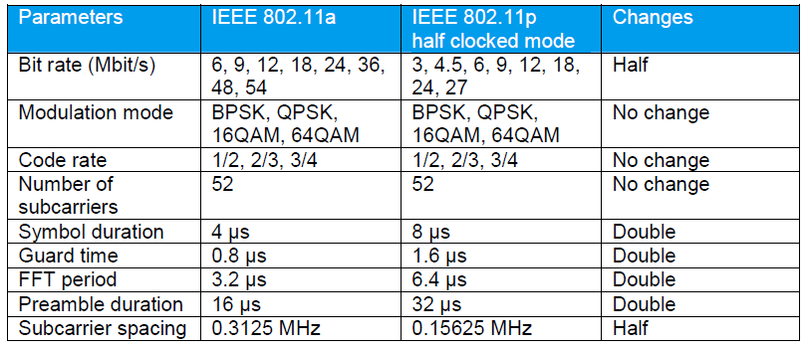
Differences between IEEE 802.11p and IEEE 802.11a

Slide 61
Differences between IEEE 802.11p and IEEE 802.11a
Narrower bandwidth (10 MHz)
Halves the occupied frequency space compared to 20 MHz in 802.11a
You speak fewer words per second but more clearly,
so the listener can catch them despite wind and echoes.
Carrier spacing halved
The 802.11p signal uses a carrier spacing reduced by ½ compared to 802.11a.
Symbol length doubled
Symbol time = 1 ÷ carrier spacing.
Halving the spacing doubles the symbol duration (from 4 µs to 8 µs, plus guard interval), improving tolerance to multipath delay spread.
"Narrower bandwidth (10 MHz) →Carrier spacing halved →Symbol length doubled
Halves data rate-->doubles symbol time = improving tolerance to multipath delay spread.

Slide 62
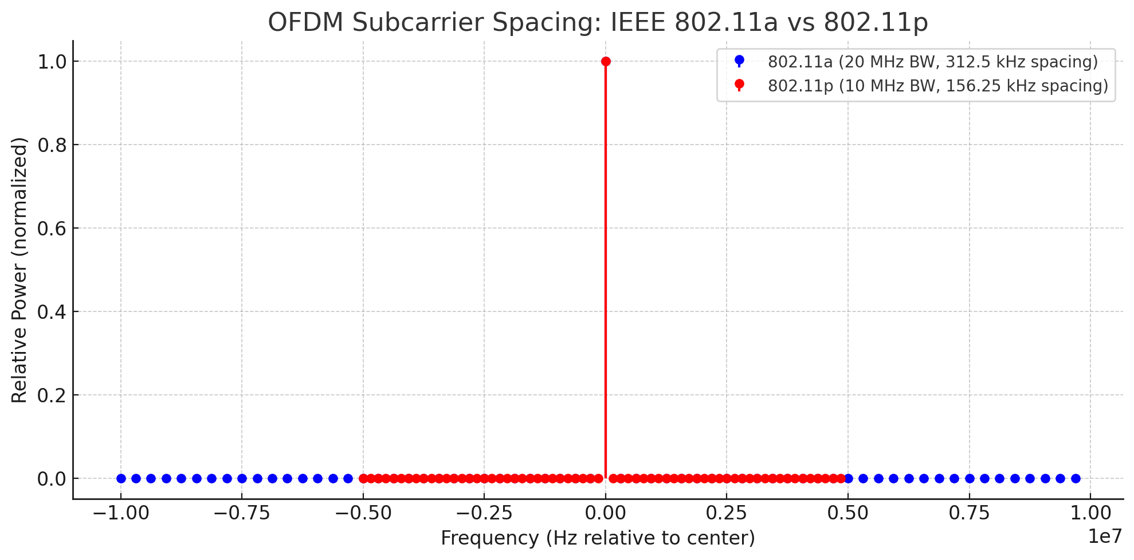
Differences between IEEE 802.11p and IEEE 802.11a
Carrier spacing halved
The 802.11p signal uses a carrier spacing reduced by ½ compared to 802.11a.
carrier spacing = bandwidth ÷ number of subcarriers.
Keeping 52 subcarriers but halving bandwidth from 20 MHz to 10 MHz halves the spacing (from 312.5 kHz to 156.25 kHz).

Slide 63
Differences between IEEE 802.11p and IEEE 802.11a
Halves data rate-->doubles symbol time = improving tolerance to multipath delay spread.
Think of it like cars on a highway:
In 802.11a (blue), the lanes (carrier spacing) are wide apart, and cars are going very fast (short symbol time).
That’s fine on a smooth, straight road, but if there are bumps (signal reflections) or gusts of wind (Doppler shifts), you can easily lose control because everything happens so quickly.
In 802.11p (red), the lanes are closer together (smaller carrier spacing) and all cars drive slower (longer symbol time).
Because they’re moving slower, they have more reaction time if a bump or gust happens —
meaning the system can handle reflections and frequency shifts without “crashing” the communication.

Slide 64

Classic IEEE 802.11
Classic IEEE 802.11 Basic Service Set (BSS)
Divides networks into logical units
Nodes belong to (exactly one) BSS
Packets contain BSSID
Nodes ignore packets from “foreign” BSSs
Exception: Wildcard-BSSID (-1) for probes
Ad hoc networks emulate infrastructure mode
Joining a BSS
Access Point sends beacon
Authentication dialogue
Association dialogue
Node has joined BSS
BSS
SSID “C”
BSS
SSID “A”
BSS
SSID “B”

Slide 65
IEEE 802.11p
New: 802.11 WAVE Mode
Default mode of nodes in WAVE
Nodes may always use Wildcard BSS in packets
Nodes will always receive Wildcard BSS packets
May join BSS and still use Wildcard BSS
BSS
SSID “A”
BSS
SSID “B”

Slide 66
IEEE 802.11p
New: 802.11 WAVE BSS
No strict separation between Host and Access Point (AP)
Instead, loose classification according to:
Equipment: Roadside Unit (RSU) / On-Board Unit (OBU)
Role in data exchange: Provider (offers service) / User (uses service)
No technical difference between Provider and User —no hardware difference.
Provider sends On-Demand Beacon
Analogous to standard 802.11-Beacon
Beacon contains all information and parameters needed to join
User configures lower layers accordingly
Starts using provided service
No additional exchange of data needed
BSS membership now only implied
There's no formal “join” process.
Once a beacon is received and used, the User is considered part of the BSS.
BSS continues to exist even after provider leaves

Slide 67
IEEE 802.11 DCF
IEEE 802.11 Distributed Coordination Function (DCF)
aka “Contention Period”
Priority access via SIFS (ACK, CTS, ...) and DIFS (payload)
Wait until medium has been free for duration of DIFS
If medium busy, wait until idle, then wait DIFS plus random backoff time
SIFS, PIFS, DIFS
Medium busy
TX starts
Time slots in contention period

Slide 68
IEEE 802.11 DCF
IEEE 802.11 Distributed Coordination Function (DCF)
Backoff if
Node is ready to send and channel becomes busy
A higher priority queue (⇨ next slides) becomes ready to send
Unicast transmission failed (no ACK)
Transmission completed successfully
Backoff: Random slot count from interval [0, CW]
Decrement by one after channel was idle for one slot (only in contention period)
In cases b) and c), double CW (but no larger than CW_{max})
In case d), set CW to CW_{min}

Slide 69
IEEE 802.11p
QoS in 802.11p (HCF)
cf. IEEE 802.11e EDCA
DIFS ⇨ AIFS (Arbitration Inter-Frame Space)
DCF ⇨ EDCA (Enhanced Distributed Channel Access)
Classify user data into 4 ACs (Access Categories)
AC0 (lowest priority)
…
AC3 (highest priority)
Each ACs has different...
CW_{min}, CW_{max}, AIFS, TXOP limit (max. continuous transmissions)
Management data e.g, WAVE Service Advertisement (WSA), Timing synchronization) uses DIFS (not AIFS)

Slide 70
IEEE 802.11p
QoS in 802.11p (HCF)
Map 8 user priorities (Min:0 Max:7) ⇨ 4 access categories ⇨ 4 queues
Queues compete independently for medium access
AC0
virtual collision
AC1
AC2
AC3

Slide 71
IEEE 802.11p
QoS in 802.11p (HCF)
IEEE 802.11e defines 8 possible priorities (0–7),
but EDCA only supports 4 queues in hardware:
AC_VO (Voice)
AC_VI (Video)
AC_BE (Best Effort)
AC_BK (Background)
AC_VO → Priority (P):6-7 # Used for safety-critical messages (e.g., BSM) → (shortest AIFS, smallest contention window.)
AC_VI → Priority (P):4-5 # Non-critical but time-sensitive infotainment.
AC_BE → Priority (P):1-3 # Default for general data.
AC_BK → Priority (P):0 # Low-priority background updates.

Slide 72
IEEE 802.11p
QoS in 802.11p (HCF)
Parameterization
Sample queue configuration
Parameter | Value
SlotTime | 13µs
SIFS | 32µs
CW_{min} | 15
CW_{max} | 1023
Bandwidth | 3 .. 27 mbit/s
Parameter | AC_BK | AC_BE | AC_VI | AC_VO
CW_{min} | CW_{min} | CW_{min} | [(CW_{min}+1)/2]-1 | [(CW_{min}+1)/4]-1
CW_{max} | CW_{max} | CW_{max} | CW_{min} | [(CW_{min}+1)/2]-1
AIFSn | 9 | 6 | 3 | 2

Slide 73
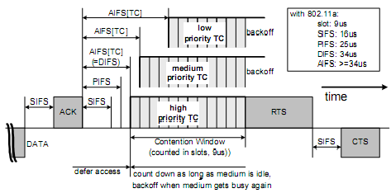
Classical IEEE 802.11
QoS in 802.11p (HCF)
Parameterization
After detecting the medium being idle for a duration of AIFS[AC] (Arbitration Interframe Space), backoff entity start down‐counting. AIFS is calculated as follow:
AIFS[AC] = SIFS + AIFSN[AC]∙aSlotTime >= 2
Min and Max of the contention window are the other parameters dependent on AC.

Slide 74
IEEE 802.11p
AC_VO
AC_VI
AC_BE
AC_BK
Backoff: 0
0
0
0
Channel Access

Slide 75
IEEE 802.11p
AC_VO
AC_VI
AC_BE
AC_BK
Backoff: 0
0
0
0
Channel busy?
Channel Access
Wait for Idle
Start Contention

Slide 76
IEEE 802.11p
AC_VO
AC_VI
AC_BE
AC_BK
Backoff: 0
0
0
0
Backoff 0?
Channel Access
Wait for backoff = 0
Wait AIFS (SIFS + AIFSn * Slot len)

Slide 77
IEEE 802.11p
AC_VO
AC_VI
AC_BE
AC_BK
Backoff: 0
Backoff: 2
0
0
0
Channel Access
Transmission
Over
Post Transmit
Backoff

Slide 78
IEEE 802.11p
AC_VO
AC_VI
AC_BE
AC_BK
Backoff: 2
2
0
0
0
Channel Access
Ch becomes
busy
AC_VI Queue ready to send… wait AIFS
Backoff

Slide 79
IEEE 802.11p
AC_VO
AC_VI
AC_BE
AC_BK
[Slot time passed]
/Decrement Backoff
Channel idle
Backoff: 2
1
Backoff: 1
2
0
0
Backoff: 0
0
Channel state changes
Channel Access
Channel busy

Slide 80
IEEE 802.11p
AC_VO
AC_VI
AC_BE
AC_BK
Queue ready to send
Higher priority queue ready
Backoff: 0
3
0
0
0
Internal Contention
Backoff
Channel Access

Slide 81
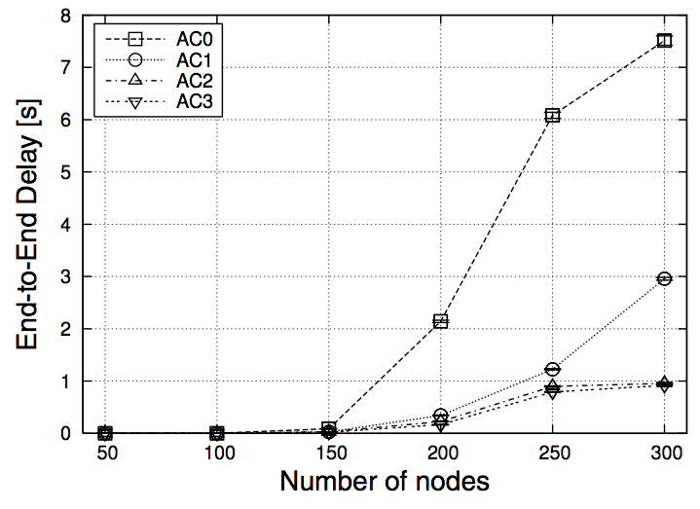
IEEE 802.11p
QoS in WAVE
mean waiting time for channel access, given sample configuration (and TXOP Limit=0 ⇨ single packet)
when channel idle:
when channel busy:
AC | CW_{min} | CW_{max} | AIFS | TXOP | t_{w} (in μs)
0 | 15 | 1023 | 9 | 0 | 264
1 | 7 | 15 | 6 | 0 | 152
2 | 3 | 7 | 3 | 0 | 72
3 | 3 | 7 | 2 | 0 | 56
Figure Source: Eichler, S., "Performance evaluation of the IEEE 802.11p WAVE communication standard," Proceedings of 66th IEEE Vehicular Technology Conference (VTC2007-Fall), Baltimore, USA, October 2007, pp. 2199-2203

Slide 82
UMTS/LTE vs. 802.11p
Pros of UMTS/LTE
Easy provision of centralized services
Quick dissemination of information in whole network
Pre-deployed infrastructure
Easy migration to (and integration into) smartphones
Cons of UMTS/LTE
High short range latencies (might be too high for safety)
Network needs further upgrades (smaller cells, multicast service)
High dependence on network operator
High load in core network, even for local communication

Slide 83
UMTS/LTE vs. IEEE 802.11p
Pros of 802.11p/Ad hoc
Smallest possible latency
Can sustain operation without network operator / provider
Network load highly localized
Better privacy (⇨ later slides)
Cons of 802.11p/Ad hoc
Needs gateway for provision of central services (e.g., RSU)
No pre-deployed hardware, and hardware is still expensive
The solution?
hybrid systems: deploy both technologies to vehicles and road, decide depending on application and infrastructure availability

Slide 84
Higher Layer Standards for IEEE 802.11p
Channel management
Dedicated frequency band at 5.9 GHz allocated to WAVE
Exclusive for V2V und V2I communication
No license cost, but strict rules
1999: FCC reserves 7 channels of 10 MHz (“U.S. DSRC”)
2 reserved channels, 1+4 channels for applications
ETSI Europe reserves 5 channels of 10 MHz
U.S. allocation | … | Critical Safety of Life | SCH | SCH | Control Channel (CCH) | SCH | SCH | Hi-Power Public Safety | …
European allocation |  | SCH | SCH | SCH | SCH | CCH | SCH | SCH
IEEE Channel |  | 172 | 174 | 176 | 178 | 180 | 182 | 184
Center frequency |  | 5.860 GHz | 5.870 GHz | 5.880 GHz | 5.890 GHz | 5.900 GHz | 5.910 GHz | 5.920 GHz
[1] ETSI ES 202 663 V1.1.0 (2010-01) : Intelligent Transport Systems (ITS); European profile standard for the physical and medium access control layer of Intelligent Transport Systems operating in the 5 GHz frequency band

Slide 85
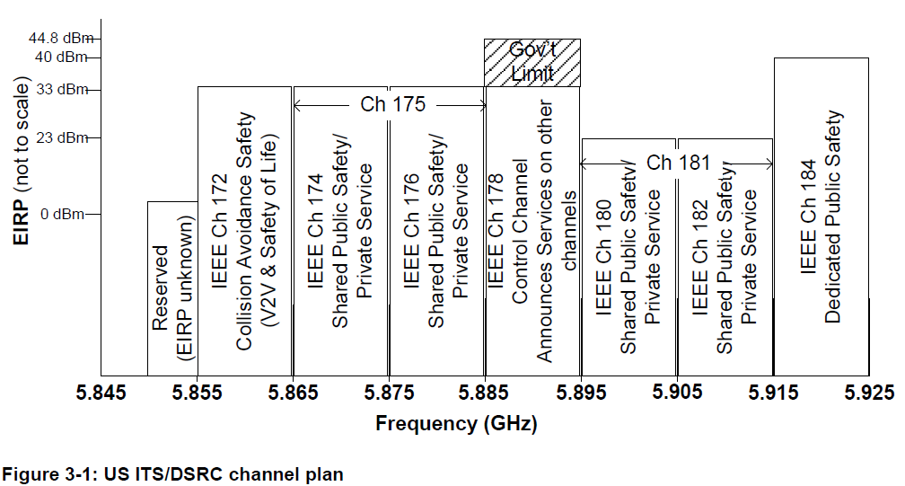
DSRC:: Channel Allocation (U.S. allocation)

Slide 86
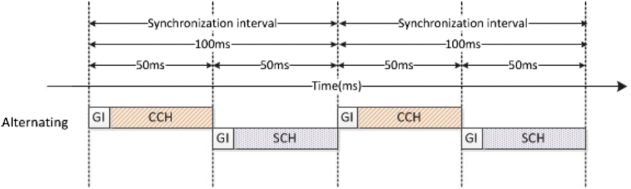
DSRC:: Channel Switching Timing
Safety Applications :
Primary Message Type: BSM (Basic Safety Message) – Periodically broadcast vehicle status (position, speed, heading).
Channel Used: Control Channel (CCH) or Safety Channel (SfCH)

Slide 87
Message Type and Channel Used
Safety Applications :
Primary Message Type: BSM (Basic Safety Message) – Periodically broadcast vehicle status (position, speed, heading).
Channel Used: Control Channel (CCH) or Safety Channel (SfCH)
Non-Safety Applications :
Primary Message Types:
WSA (WAVE Service Advertisement) – Broadcasts the availability of a service on a specific channel.
WSM (WAVE Short Message) – Payload message sent after WSA received/accepted.
Channel Used: Service Channels (SCHs) (e.g., 5.860 GHz–5.880 GHz, 5.910 GHz–5.920 GHz)

Slide 88
Higher Layer Standards for IEEE 802.11p
Need for higher layer standards
Unified message format
Unified interfaces to application layer
U.S.
IEEE 1609.*
WAVE („Wireless Access in Vehicular Environments“)
Europe
ETSI
ITS G5 (“Intelligent Transportation Systems”)

Slide 89
IEEE 1609.* upper layers (building on IEEE 802.11p)
IEEE 1609.2: Security
IEEE 1609.3: Network services
IEEE 1609.4: Channel mgmt.
IEEE 1609.11: Application “electronic payment”
Security
Management
TCP / UDP
WSMP
IPv6
1609.3
LLC
1609.2
Channel Coordination, WAVE MAC
1609.4
WAVE PHY
WAVE PHY
802.11p
[1] Jiang, D. and Delgrossi, L., "IEEE 802.11p: Towards an international standard for wireless access in vehicular environments," Proceedings of 67th IEEE Vehicular Technology Conference (VTC2008-Spring), Marina Bay, Singapore, May 2008
[2] Uzcátegui, Roberto A. and Acosta-Marum, Guillermo, "WAVE: A Tutorial," IEEE Communications Magazine, vol. 47 (5), pp. 126-133, May 2009

Slide 90
IEEE 1609
Channel management
WAVE allows for both single radio devices & multi radio devices
Dedicated Control Channel (CCH) for mgmt and safety messages ⇨ single radio devices need to periodically listen to CCH
Time slots
Synchronization envisioned via GPS receiver clock
Standard value: 100ms sync interval (with 50ms on CCH)
Short guard interval at start of time slot
During guard, medium is considered busy (⇨ backoff)
CCH interval
“SCH” interval
CCH interval
“SCH” interval
t = n × 1s
[1] IEEE Vehicular Technology Society, "IEEE 1609.4 (Multi-channel Operation)," IEEE Std, November, 2006

Slide 91
IEEE 1609
Packet transmission
Sort into AC queue, based on WSMP (or IPv6) EtherType field, destination channel, and user priority
Switch to desired channel, setup PHY power and data rate
Start medium access
Channel Router
SCH
AC0
virt. Collision
Channel selection and setup
Channel access
AC1
AC2
AC3
CCH
AC0
virt. Collision
AC1
AC2
AC3

Slide 92
IEEE 1609
Channel management
Control Channel (CCH):
Default channel upon initialization
BSM(Basic Safety Message), WAVE service advertisements (WSA)
Channel parameters take fixed values
Service Channel (SCH):
Only after joining WAVE BSS
WAVE short messages (WSM), IP data traffic (IPv6)
Channel parameters can be changed as needed

Slide 93
IEEE 1609
WAVE service advertisement (WSA)
Broadcast on Control Channel (CCH)
Identifies WAVE BSSs on Service Channels (SCHs)
Can be sent at arbitrary times, by arbitrary nodes
Only possibility to make others aware of data being sent on SCHs, as well as the required channel parameters to decode them
Node A
Node B
WSA (on CCH)
Data (on S-CH)
Data (on S-CH)

Slide 94
Loss Model

Slide 95
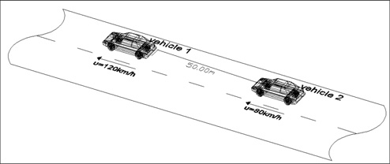
Loss Model::Line Of Sight
The term LOS path is referred the situation where we have visual line of sight contact between the transmitting antenna and the receiving antenna.
The Ricean distribution can be used for modeling small-scale fading

Slide 96
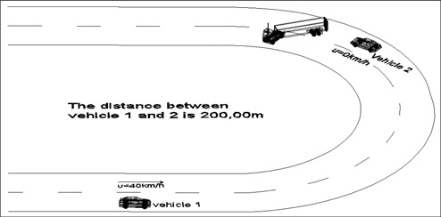
Loss Model:: Non-Line Of Sight
For the N-LOS path it is found that the amplitude of the received signal due to fading obeys Rayleigh fading distribution and the delay spreads were several times greater than that for the LOS.

Slide 97
Vehicular Networking
Book design © 2014 Cambridge University Press

